Slide 1
Northwind Study Case Project Report
Gatum Erlangga

Slide 2
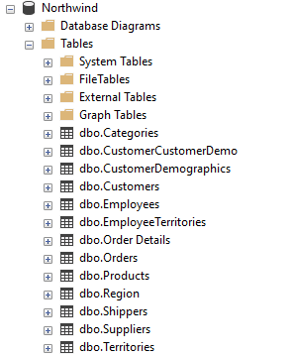
About
Northwind Dataset by Microsoft
Northwind is a dataset about an imaginary company called northwind. This company specialized in products export and import. It consists of n tables with total size of 2MB.

Slide 3
Study Case Focus
With leading questions
Customer Analysis
Product Analysis
Employee Analysis
Do we have and who our loyal customer?
Is there any patterns related to our product sales?
Who has the most contributions to the customer orders?

Slide 4
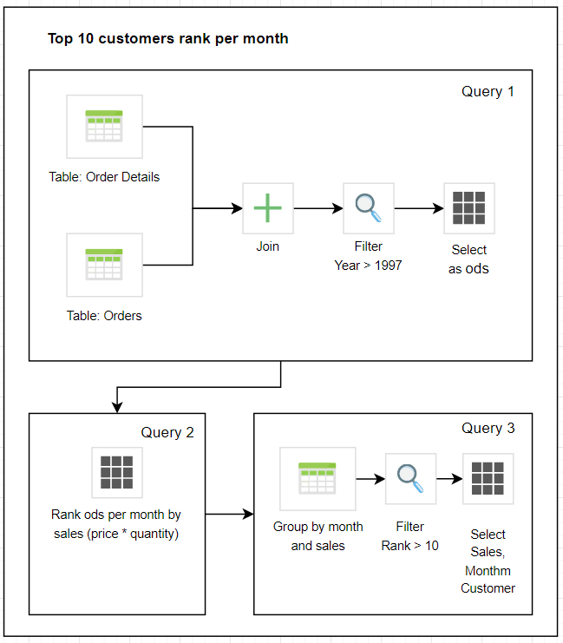
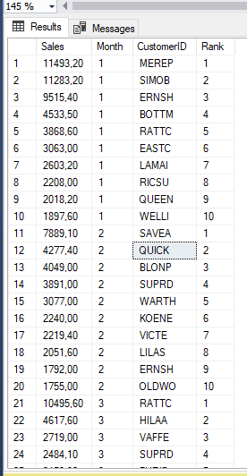
Data Preparation Process
Customer Analysis: Loyal Customer
Data Engineering Process
Sample Output

Slide 5
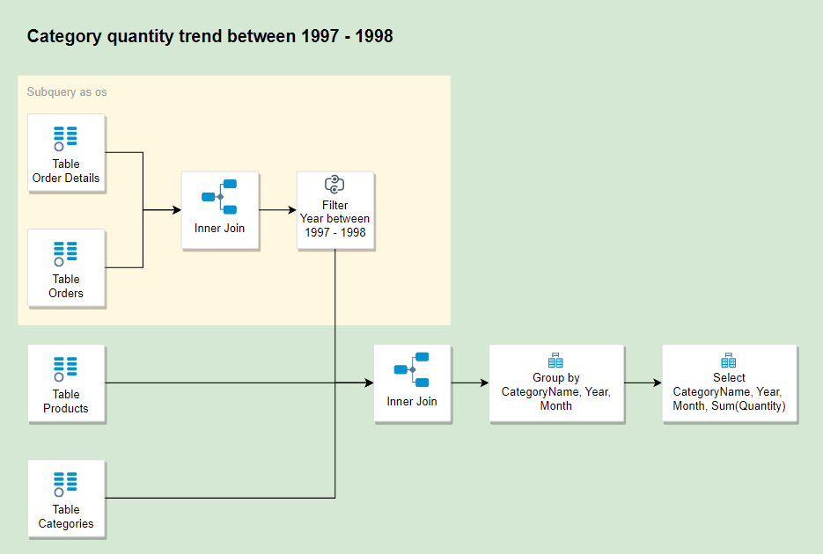
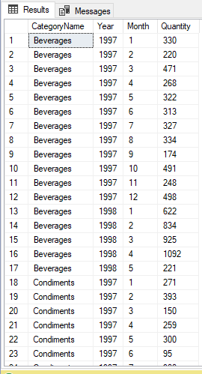
Data Preparation Process
Product Analysis: Product’s Category Trends (1997-1998)
Data Engineering Process
Sample Output

Slide 6
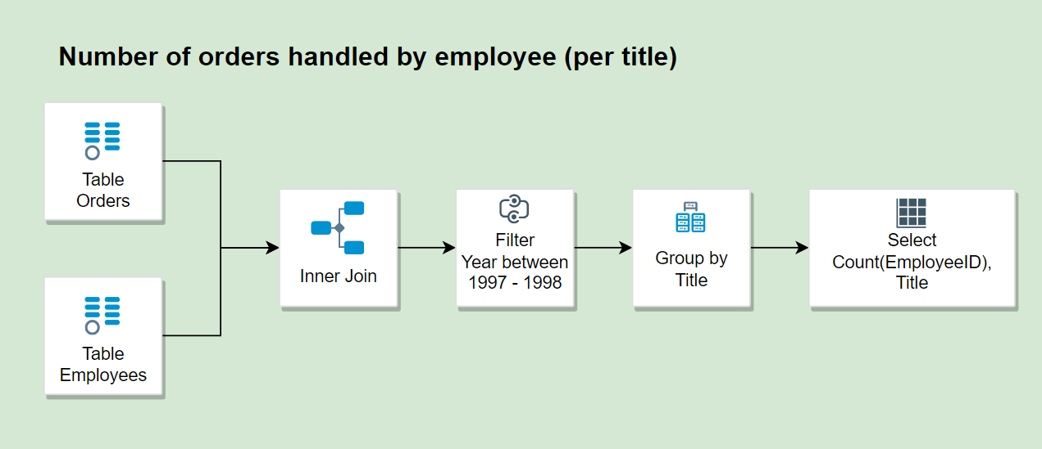
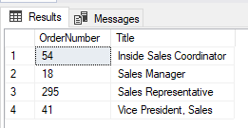
Data Preparation Process
Employee Analysis: Total order per employee’s title
Data Engineering Process
Sample Output

Slide 7
Data Analysis and Visualization

Slide 8
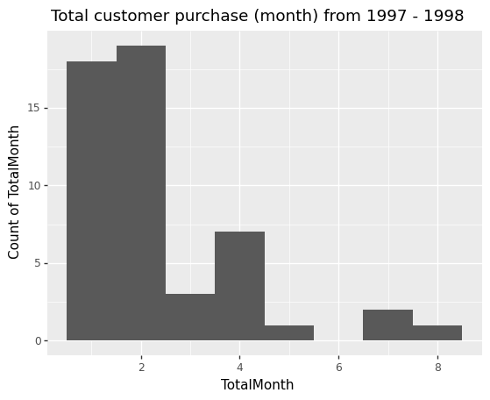
Customer Analysis: Loyal Customer
Many customers only purchase on certain month (not on every month)
Only the small number having the consistent purchase every month

Slide 9
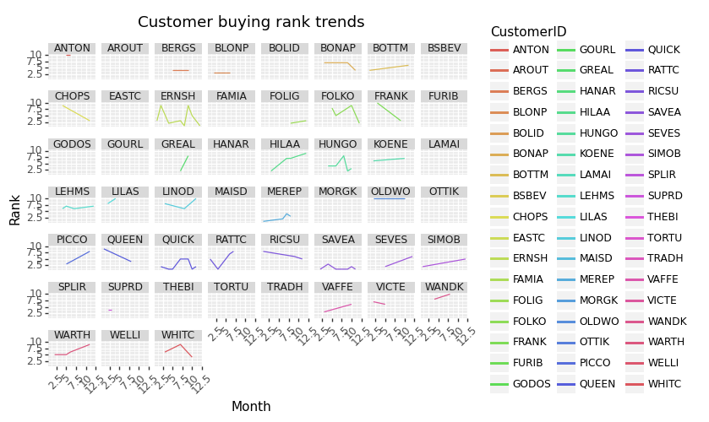
Customer Analysis: Loyal Customer
This image illustrate customer’s rank over the 12 month. Only top 10 customers are included in this graphic.
Top 10 customers selected from total sales they made per month.

Slide 10
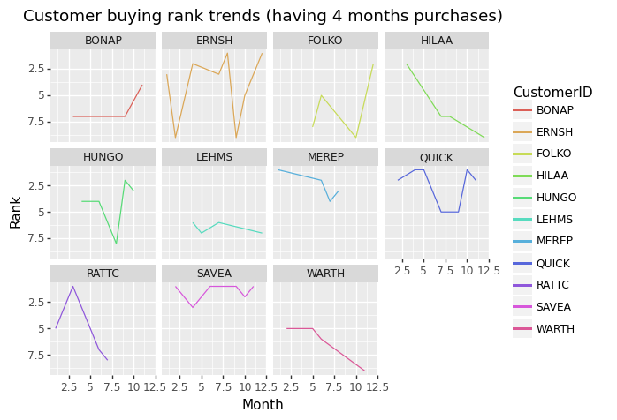
Customer Analysis: Loyal Customer
To narrow down the visualization, only customer have purchase in 4 months were selected in this chart.
Most of them consistently become the top 10 in the middle of the year!

Slide 11
Customer Analysis: Loyal Customer
Recommendation
Add discount to their favourite products on the non buy month to increase sales on certain customer.
Add reward if their have retain their position for 12 month.

Slide 12
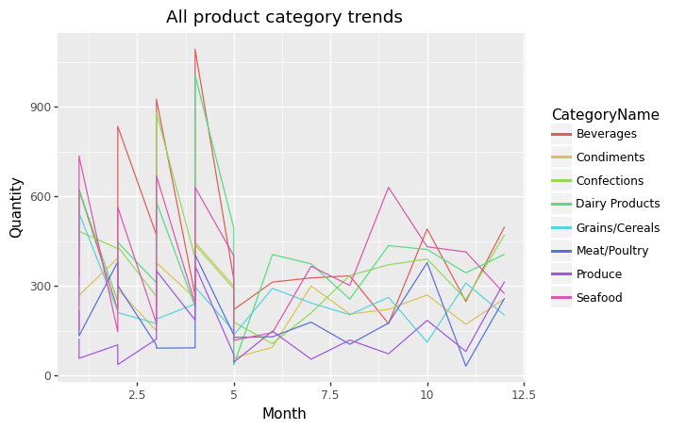
Product Analysis: Product’s Category Trends
For the first 5 month, there is a consistent seasonal pattern of the product sells.
After 5 month, it start to increase.

Slide 13
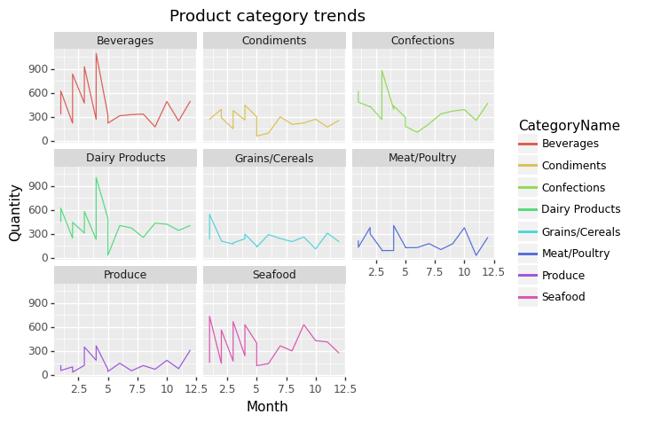
Product Analysis: Product’s Category Trends
Overall, each product category reaches its peak on the first semester of the year. It can be seen that beverages, dairy products, confections, seafood and produce have the same pattern.
Besides this seasonal pattern, there are some consistent trends among condiments, grains/cereals, meat/poultry and produce products.

Slide 14
Product Analysis: Product’s Category Trends
Recommendation
Further analysis on the first 5 months seasonal pattern to optimize warehouse and product’s stock.
After the first 5 months, add necessary discount to the certain products to increase sales.

Slide 15
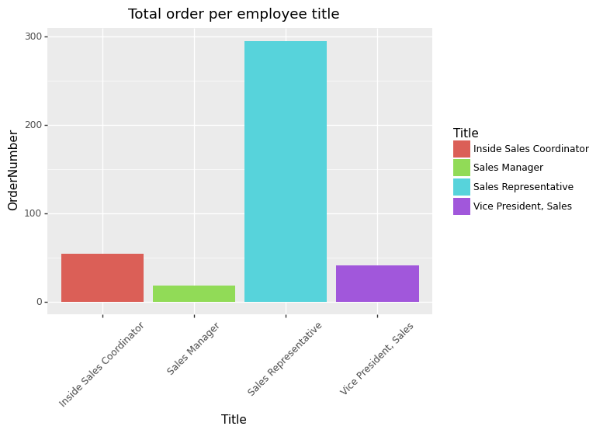
Employee Analysis: Total order per employee’s title
Sales representative has the most order numbers!

Slide 16
Employee Analysis: Total order per employee’s title
Recommendation
Hire more employee for this role (To balance their task and prevents burn out).

Slide 17
Conclusion
To improve customer loyalty:
Add discount to their favourite products on the non buy month to increase sales on certain customer.
Add reward if their have retain their position for 12 month.
Product improvement:
Further analysis on the first 5 months seasonal pattern to optimize warehouse and product’s stock.
After the first 5 months, add necessary discount to the certain products to increase sales.
Improve employee’s efficiency:
Hire more employee for this role (To balance their task and prevents burn out).
Slide Template by https://slidesgo.com/

